Slide 1
(Almost) Hands-Off
Information Integration for the
Life Sciences
Ulf Leser, Felix Naumann

Slide 2
Aladin
Basic idea
  Urgent need for data integration in the life sciences
  Life science databases have certain characteristics
  Life science database users have certain intentions
  These can be exploited to automate integration
ALmost Automatic Data INtegration
for the Life Sciences
  Minimize manual effort
  Keep quality of integrated data as high as possible
  Use domain-specific heuristics
Notes:
Auf Englisch ist es „Aladdin“ – but we cold not find a second „d“ in the right place (and didn‘t know the correct English spelling when we thought about a name for the project)

Slide 3
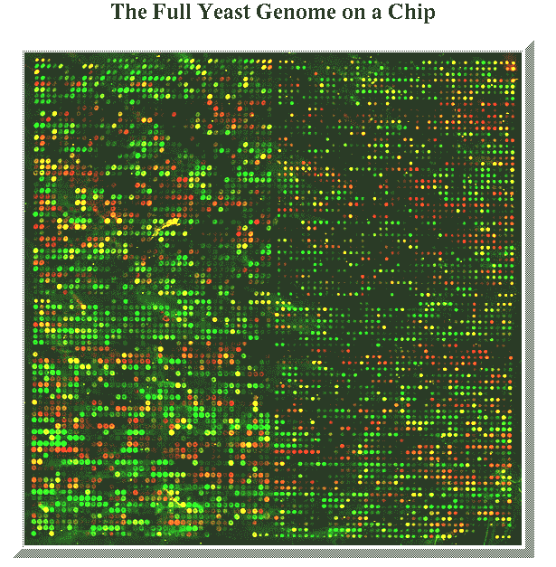
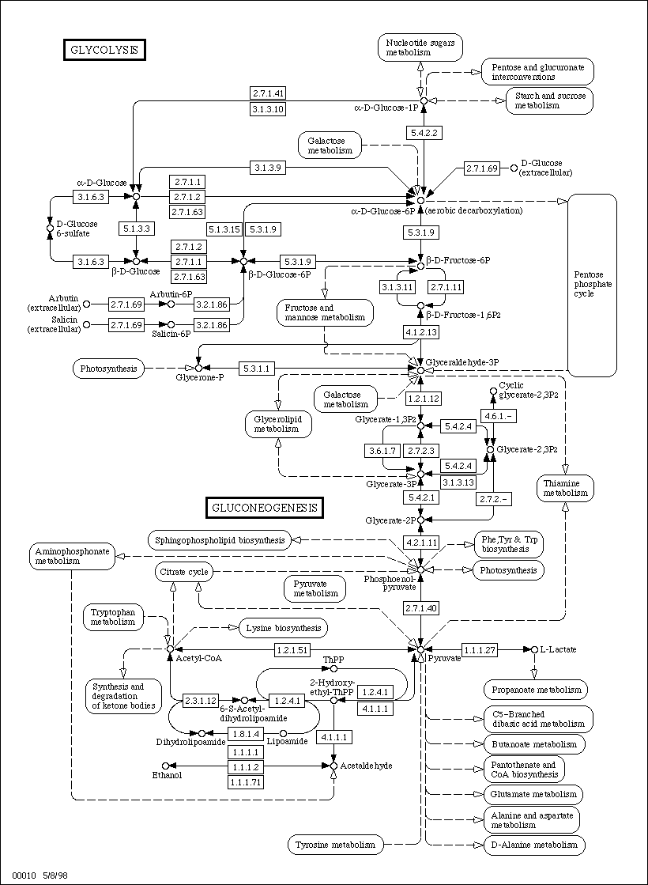
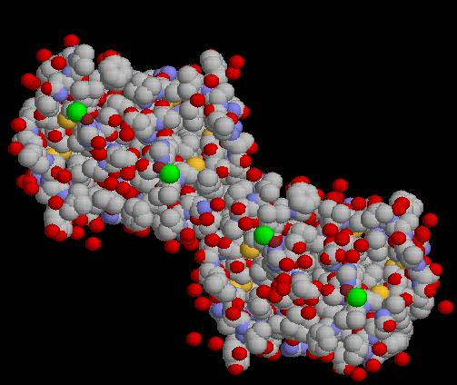
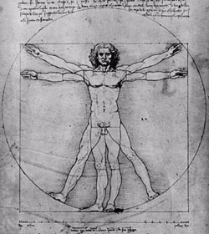
Integration?
Database integration
Schema level
Data integration
Data level
Export schema
Export schema
Federated schema
Federated schema
Export schema
Export schema
Export schema
Component schema
Component schema
Component schema
Local schema
Local schema
Local schema
Data
Data
Data
Source
Source
Source
Notes:
Projects in life sciences can be classified as either .. Or ...
Data integration = Data fusion
Database integration requires a database with schemas; data integration does not

Slide 4
Two Cultures of Integration
Schema-driven (computer scientists)
  Much smaller than data, (hopefully) well-defined elements
  Resolve redundancy and heterogeneity at the schema level
  High degree of automation once system is set-up
  Focus on methods - you rarely publish a “data paper”
Data-driven (biologists)
  Value is in the data, abstraction is a result of analysis
  Don‘t bother with schemas
    Abstraction is volatile and depends on experimental technique
  Manual integration at data level, constant high effort
  You rarely publish a (database) “method paper”
Notes:
Schemas are abstraction of data
You rather build middleware, not a concrete system

Slide 5
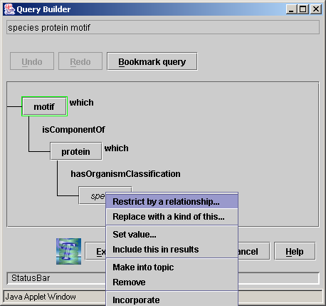

Two Cultures: TAMBIS & SWISS-PROT
Semantic middleware
6 sources, 1200 concepts
Ever adopted in any other project?
  Integrated schema difficult to understand
  No agreement on “global” concepts
  Data provenance
Database of protein sequences
Papers, pers. comm., ext. databases, …
Large effort: 30+ data curators
  Gold standard database
Mostly perceived and used as a book
Notes:
SP „provenance“ is achieved through references to papers or other databases

Slide 6
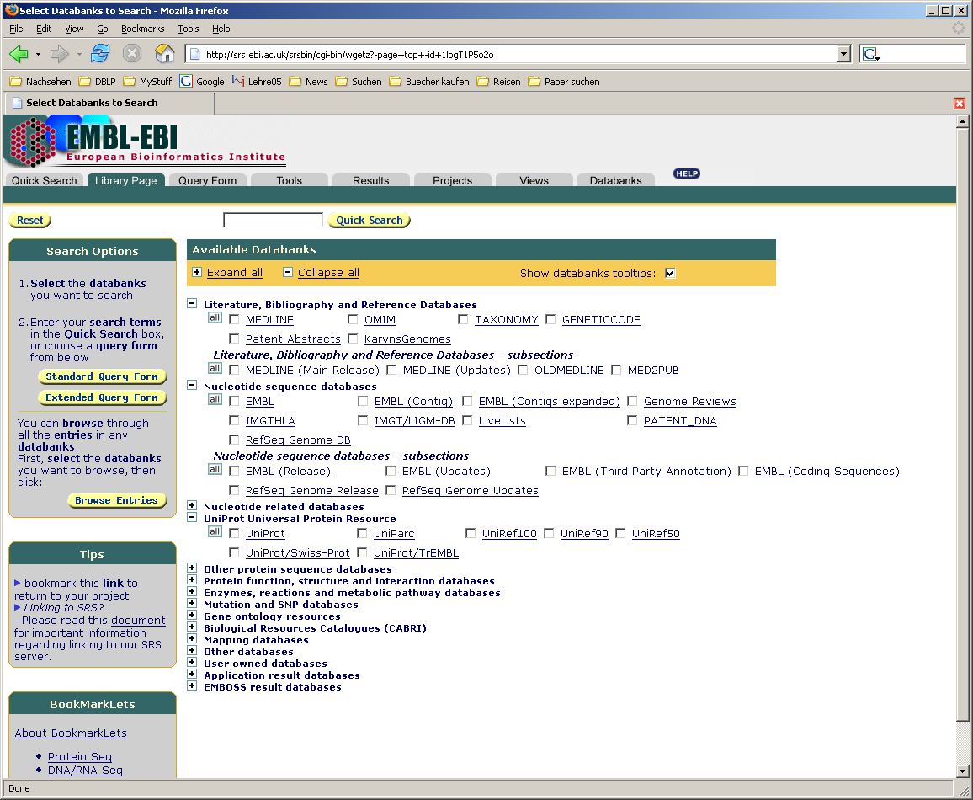
Linking Associated Objects
Schema-driven
  Too abstract; tends to blur data provenance
Data-driven
  Costly and time-consuming; inadequate use of DB technology
Alternative: Concentrate on object links
Example: SRS
  Maps a flat-file into a semi-structured,
  “one class” representation
  Never mixes data from diff. sources
  Use cross-references for navigation and joins

Slide 7
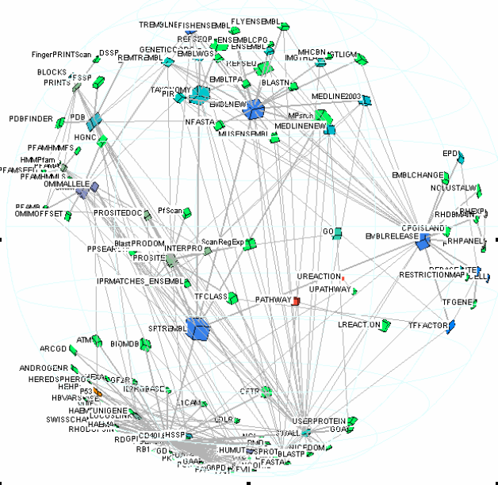
Cross-References

Slide 8
Aladin’s Scenario
Assumptions
  Integration of many, many biological databases
  As little manual interventions as possible
  Do not merge data from different databases
Challenges
  Push automation as far as possible without lowering quality of integrated data too much
  Systematically evaluate quality of automatic integration
Why will it work?
  Integrate by generating / finding links between objects
  Exploit characteristics of life science databases

Slide 9
Properties – and how to use them
Data sources have only one “type” of object
Objects have nested, semi-structured annotations
Detect hierarchical structure
Objects have stable, unique accession numbers
Databases heavily cross-reference each other
Detect objects
Detect existing cross-references
Objects have rich annotations (often free text, sequences)
Detect further associations based on “similarity”

Slide 10
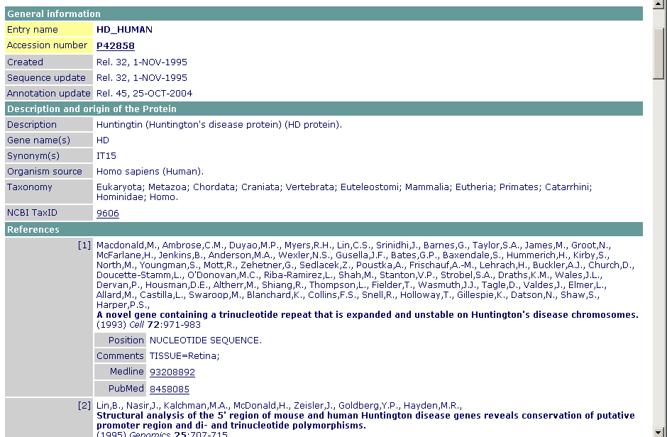
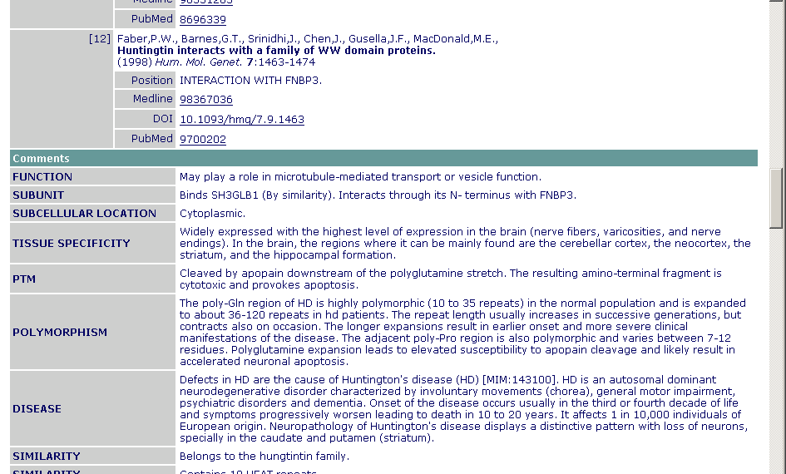
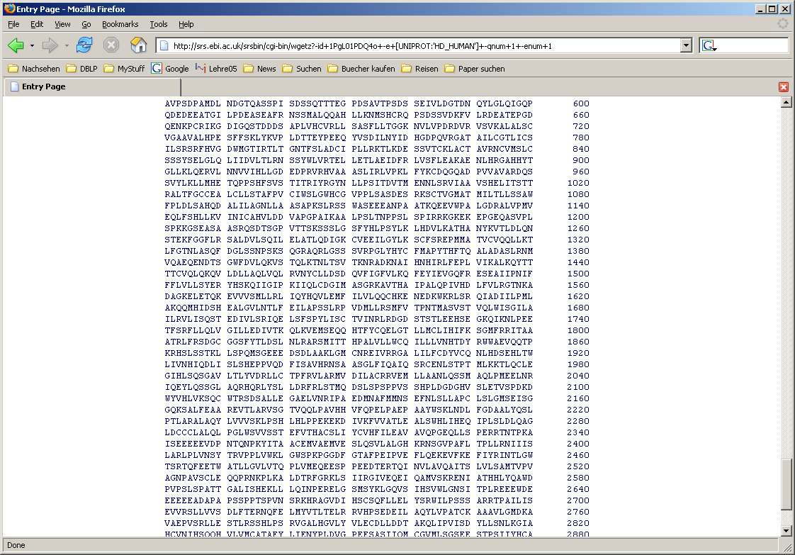
A Biological Database

Slide 11
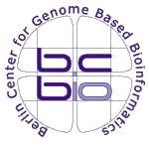

Columba: Multidimensional Integration
Interdisciplinary project
Integrates 15 sources annotating protein structures
Sources are dimensions for PDB entries
Neither data nor schema integration - links
SCOP
Class
Fold
Superfamily
SwissProt
Description
Domains
Feature
Advantages
  Users recognize their sources
  Intuitive query concept
  “Relatively” easy to maintain/extend
CATH
Class
Architecture
Topology
Homolog. sf
PDB
PDB_ID
Compounds Chains
Ligands
GeneOntology
Terms
TermRelations
Ontologies
DSSP
Secondary
structure
elements
KEGG
Pathway
Enzyme
EC Number

Slide 12
Columba Experiences
= Aladin’s assumptions
  Relational approach feasible: Sources are downloadable, parsers exist
  Databases are collections of each one type
  Hierarchical structure, only 1:n relationships
  Objects have unique accession numbers
  Importance of and lack of cross references
Lessons learned
  Schema reengineering is extremely time-consuming
    Although we will only use a small part at the end
  There is more demand than resources
Why not be less specific about which data to integrate, but much faster?

Slide 13
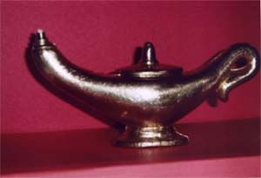
Materialized Integration
Data
Warehouse
BIND
Brenda
PDB
OMIM
Genbank
SWISSPROT
PubMed
KEGG

Slide 14
Materialized Integration
Aladin
BIND
Brenda
PDB
OMIM
Genbank
SWISSPROT
PubMed
KEGG
Notes:
Impliziert:
Zentraler Zugriffsdienst, ein Schema
Virtuelle Integration, Anfrageübersetzung zur Laufzeit.

Slide 15
Five Steps to Integration
Source-specific
Download source, parse, import into RDBMS
Guess primary objects
Guess (hierarchically structured) annotation
Across data sources
Guess cross-references
  Objects sharing some piece of information
Guess duplicates
  Highly similar objects

Slide 16
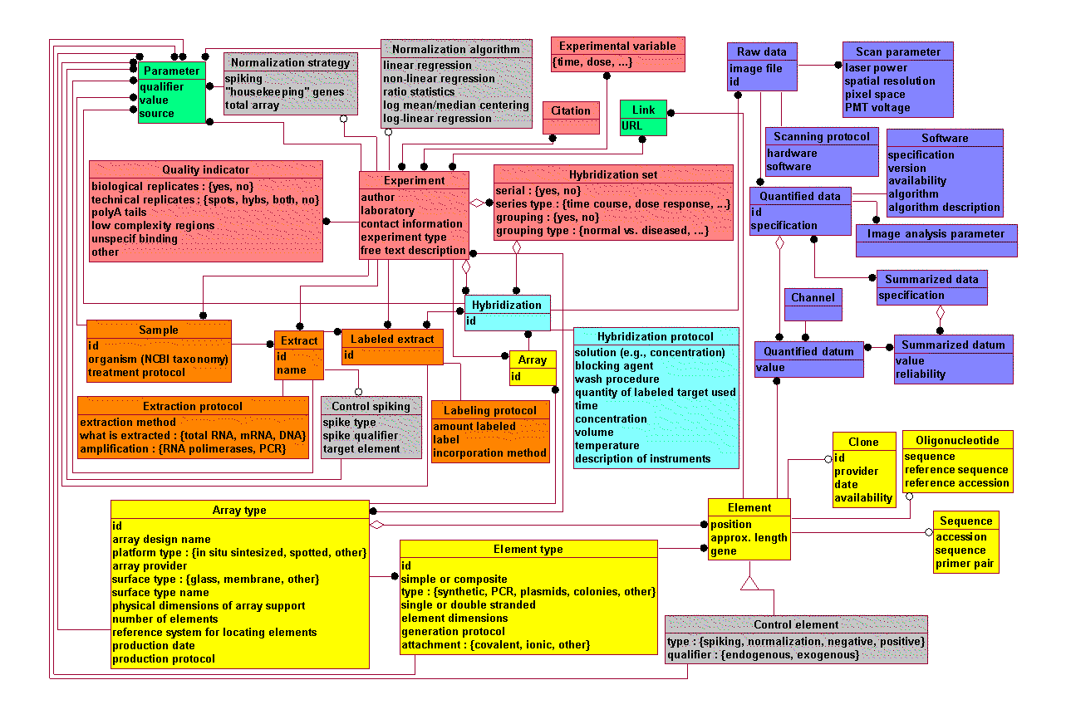
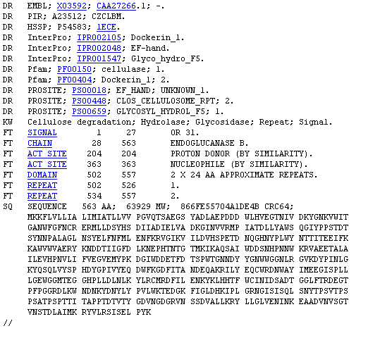
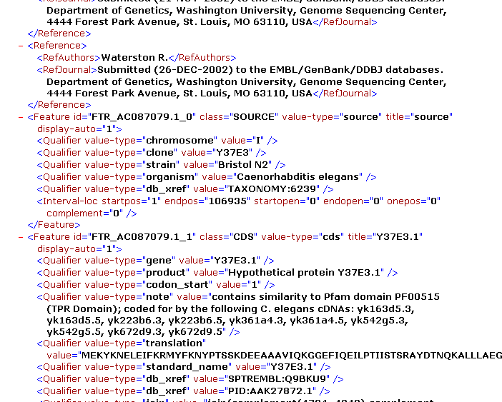
Overview – Steps 1-3
Steps 2 and 3
Guess primary objects
Guess accession number
Guess / find FK constraints
Step 1
Parse and import
Arbitrary target schema
With or without FK constraints
Notes:
Andere Folie von Felix nehmen ohne grüne Farben!!!!

Slide 17
Overview – Steps 4+5
Step 5
Guess duplicates
Different degrees of
“duplicateness”
Step 4
Guess existing cross-refs
Compute new cross-refs

Slide 18
1. Download, parse, import
Q: Is that possible in an automatic way?
Q: What is the target schema?
Answers
  Here, some manual work is involved, but …
  Parsers are almost always available (BioXXX)
  Aladin doesn‘t mind the target schema
  Target schemas are completely source-specific
  … may or may not contain FK constraints (MySql is …!)
  But: Universal relation won’t work
Notes:
Konkrete Beispiele-BioSQL, mSD, BioPython, BioPerl, ...

Slide 19
2. Guess Primary Objects
Q: What’s a primary object?
Q: How do you find them?
Answers
  A database is a collection of objects of one type
    Many biological databases started as books
  These primary objects have stable accession numbers
  Accession numbers look very much the same
    P0496, DXS231, 1DXX, …
    Analyze length, composition, variation, uniqueness, NOT NULL
  But: Databases may have more than one primary type

Slide 20
3. Guess Dependent Annotation
Q: Can we detect dependency from data?
Q: What about complex relationships?
Answers
  Hierarchical annotation means 1:1 or 1:n relationships
    Annotations don’t reference each other
    No m:n - especially flat-file parsers don’t generate m:n
  Guess or use primary keys and foreign key constraints
    Unique and not null; subset relationship; surrogate keys; …
  Lot of previous work, e.g. [KL92], [MLP02], …

Slide 21
4. Guess Associations between Objects
Q: How can we find existing cross-refs?
Q: How can we generate new cross-refs?
Answers
  An existing cross-reference is essentially a pair of identical accession numbers in two different data sources
    Same characteristics as accession number (minus uniqueness)
  Guess new cross-refs based on similarity of attribute values
    Similarity of text fields (text mining), sequences, …
  Note: cross-refs are on the object level – need to be stored
  Lot of previous work, e.g. [NHT+02], [HBP+05], [AMS+97]
Notes:
Referenzen, existing technique
Bilder raus

Slide 22
5. Guess Duplicates
Q: If we don’t even know classes – what’s a duplicate?
Answer
  Most difficult part, but there are many kind-of duplicates
    Are sequence-identical genes in different species the same?
  Need for varying degrees of “duplicateness”
    Data level (overlap in attribute values)
    Schema-level (schema matching)
  Note: No removal or merging of duplicates
  Lot of previous work, e.g. [MGR+02], [BN05], [MLF04], …
Notes:
Schemaüberlappungsbildchen – hat Felix geschickt

Slide 23
Caveats
Not meant for high-throughput data
  Proteomics profiling, gene expression databases
  Targets “knowledge-rich” databases
Resulting warehouse will contain errors
  Wrong cross-refs, misinterpreted structure, missing links
  Requirement: Measure quality of Aladin’s methods
    Use existing integrated databases as gold standard
    Precision/recall measures can be derived for all steps
Intended for human usage, not for automatic further processing

Slide 24
Summary
Five step (almost) automatic integration procedure
  Depends on domain characteristics
  Guesses primary objects, annotations, cross-references, duplicates
  Neither schema integration nor data fusion – links
Which quality does Aladin achieve?
  We don’t know yet – needs to be evaluated
Issue: Scalability
  Needs many, many comparisons of tables, tuples, values
  But: Incremental integration, sampling, pruning
Issue: Searching and result presentation
  Full text search, browsing
  But: Queries across sources possible for advanced users
Notes:
Anfragemethode als open issue

Slide 25
Acknowledgements Columba
Humboldt University
Silke Trissl
Heiko Müller
Raphael Bauer
Charite
Kristian Rother
Stefan Günther
Robert Preissner
Cornelius Frömmel
Conrad-Zuse Center
Rene Heek
Thomas Steinke
Technische Fachhochschule
Patrick May
Ina Koch
Funding: BMBF

